Slide 1
ECEG-5193: Algorithm Analysis and Design
Basics of Algorithm Analysis
Backtracking

Slide 2
Backtracking
Backtracking: An algorithm design technique that
Tries a partial solution and then abandons it ("backtracking") if it is not suitable.
a "brute force" algorithmic technique (tries all paths; not clever)
often (but not always) implemented recursively
Applications:
producing all permutations of a set of values
parsing languages
games: anagrams, crosswords, word jumbles, 8 queens
combinatorics and logic programming

Slide 3
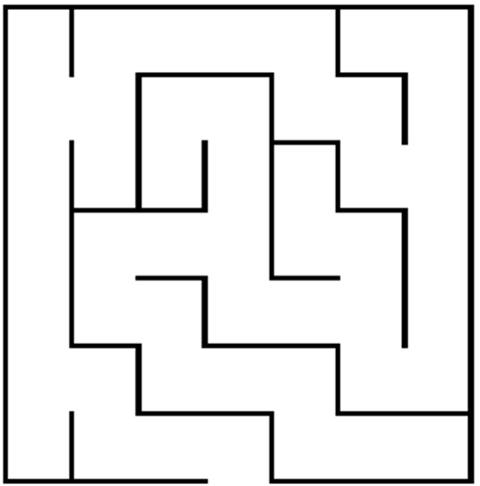
Backtracking in Action
for (dir = UP; dir <= LEFT; dir++) { if (!WallExists(pt, dir)) {if (SolveMaze(AdjPt(pt, dir))) return(TRUE);
}

Slide 4
Backtracking in Action
for (dir = UP; dir <= LEFT; dir++) { if (!WallExists(pt, dir)) {if (SolveMaze(AdjPt(pt, dir))) return(TRUE);
}

Slide 5
Backtracking in Action
for (dir = UP; dir <= LEFT; dir++) { if (!WallExists(pt, dir)) {if (SolveMaze(AdjPt(pt, dir))) return(TRUE);
}

Slide 6
Backtracking in Action
for (dir = UP; dir <= LEFT; dir++) { if (!WallExists(pt, dir)) {if (SolveMaze(AdjPt(pt, dir))) return(TRUE);
}

Slide 7
Backtracking in Action
for (dir = UP; dir <= LEFT; dir++) { if (!WallExists(pt, dir)) {if (SolveMaze(AdjPt(pt, dir))) return(TRUE);
}

Slide 8
Backtracking in Action
for (dir = UP; dir <= LEFT; dir++) { if (!WallExists(pt, dir)) {if (SolveMaze(AdjPt(pt, dir))) return(TRUE);
}
This path reaches a dead end.
Time to backtrack!
Remember the program stack!

Slide 9
Backtracking in Action
for (dir = UP; dir <= LEFT; dir++) { if (!WallExists(pt, dir)) {if (SolveMaze(AdjPt(pt, dir))) return(TRUE);
}
The recursive calls end and return until we find ourselves back here.

Slide 10
Backtracking in Action
for (dir = UP; dir <= LEFT; dir++) { if (!WallExists(pt, dir)) {if (SolveMaze(AdjPt(pt, dir))) return(TRUE);
}
The recursive calls end and return until we find ourselves back here.
And now we try RIGHT

Slide 11
Backtracking in Action
for (dir = UP; dir <= LEFT; dir++) { if (!WallExists(pt, dir)) {if (SolveMaze(AdjPt(pt, dir))) return(TRUE);
}
And now we try DOWN

Slide 12
Backtracking in Action
for (dir = UP; dir <= LEFT; dir++) { if (!WallExists(pt, dir)) {if (SolveMaze(AdjPt(pt, dir))) return(TRUE);
}
Path Eventually Found

Slide 13
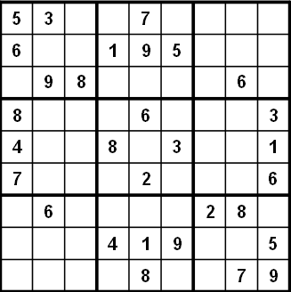
Solving Sudoku
1
2
4
8
9
6
Backtrack

Slide 14
Solving Sudoku
Backtracking

Slide 15
Solving Sudoku
Stacks and trees can be utilized to solve problems such as crosswords, Sudoku, 8-queens puzzle, and many other puzzles
In other words,
Each choice (tree children) is recorded (in a stack)
When you run out of choices for the current decision, you pop the stack, and continue trying different choices for the previous decision

Slide 16
Backtracking
At each node, beginning w/ root, you choose one of its children to move to, and repeat ‘till you get to a leaf
Suppose you get to a bad node/leaf
Do backtrack to continue the search for a good leaf by canceling your most recent choice (pop stack) and trying out the next option in that set of options
Recursion or stack
If you end up at the root w/ no options left, no good leaf

Slide 17
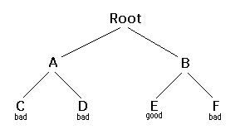
Backtracking
Starting at Root, your options are A and B. You choose A.
At A, your options are C and D. You choose C.
C is bad. Go back to A.
At A, you have already tried C, and it failed. Try D.
D is bad. Go back to A.
At A, you have no options left to try. Go back to Root.
At Root, you have already tried A. Try B.
At B, your options are E and F. Try E.
E is good.

Slide 18
Backtracking
Generic backtracking algorithm w/ recursion
boolean solve(Node n)
{
if n is a leaf node
{
if the leaf is a goal node, return true
else return false
}
else
{
for each child c of n
if solve(c) succeeds, return true
return false
}
}

Slide 19
Backtracking – using stacks
boolean solve(Node n)
{
push node n on the stack S;
while S is not empty {
if S.top() node is a leaf {
if it is a goal node, return true
else pop it off S
}
else if S.top() node is unmarked {
Mark S.top() node
for each child c of S.top() node
push c to S
}
else //not a leaf and marked pop it off S
}
return false
}
Notes:
Generic backtracking algorithm w/o recursion (w/ stacks)

Slide 20
Backtracking Examples

Slide 21
Backtracking Method
Find all permutations of 3 binary variables
Generate nodes in Depth First order.
Kill nodes (and their children) not satisfying constraints.
Backtrack to higher level to seek a different path to a leaf node.
If all leaves are killed, the problem has no solution.

Slide 22
The problem
Find all permutations of 3 binary variables such that no two consecutive values are the same.
x = {x₁ , x₂, x₃} with each value selected from a set of 2 values v = {0 , 1}
n = 3 , x_{k} = 0 or 1 , k = 1 , 2 , 3, m = 2
Total number of brute force permutations = 2 * 2 * 2 = 8
Implicit Conditions: x₁ ≠ x₂ , x₂ ≠ x₃
The permutation tree has 3 layers, one layer for each variable.

Slide 23
Backtracking Permutation Tree
1
x₁
0
1
2
9
x₂
0
1
x₂
0
1
3
6
10
13
x₃
0
1
x₃
0
1
x₃
0
1
x₃
0
1
4
5
7
8
11
12
14
15

Slide 24
Backtracking Permutation Tree
Find all permutations of 3 binary variables such that no two consecutive values are the same
1
x₁
0
1
2
9
x₂
0
1
x₂
0
1
3
3
6
10
13
13
x₃
0
1
x₃
0
1
x₃
0
1
x₃
0
1
3
3
4
5
7
8
11
12
14
15
8
11
14
15
{0,1,0}
{1,0,1}

Slide 25
The Solution
# of solution states = # of leaves = 8
Total # of nodes in tree = measure of brute force cost = 15
# of nodes generated = measure of Backtracking cost = 11
# of surviving nodes = 7
# of killed parent nodes = 4
# of answer states (3-tuples) = 2
X₁ = {0,1,0} , X₂ = {1,0,1}

Slide 26
Conclusion
Let N_{e} and N_{b} be the number of nodes generated by the exhaustive search and backtracking methods, respectively.
A measure of the Gain obtained by backtracking is
G = (1 – N_{b} / N_{e})*100 %
For the previous example, G = (1 – 11/15)*100 = 26.7%
Notes:
Backtracking is a Divide & Conquer Brute Force (exhaustive) search with pruning.
Saves time by killing internal nodes that have no useful leaves.

Slide 27
Sum of Subsets
The Problem
Given a set W of positive integers w_{i} ,
i = 1,2,…,n and m, find all subsets of W whose sums are equal to m.
Example: n = 4 , W = {11,13,24,7},
m = 31

Slide 28
The Problem (cont.)
Constraints:
1. A member appears only once in the subset.
2. The sum of a subset is exactly m.
3. No multiple instances of the same subset. For example:
{1,4,2} and {1,2,4}
This is satisfied by requiring w_{i} < w _{i+1}

Slide 29
Backtracking Solution
Consider the previous example with
n = 4 ,
W = {11,13,24,7}, m = 31
Let X = {x₁, x₂, … , x_{n}} be a solution such that x_{i} ∈ {0,1} , x_{i} = 1 if w_{i} is selected and x_{i} = 0 otherwise. Hence, we obtain fixed-size tuples.

Slide 30
Brute Force Permutation Tree
The permutation tree will be a complete binary tree with a height of n+1.
The # of leaves (possible subsets) will be
2^{n} = 16 and the total # of nodes will be 31.

Slide 31
Sum of Subsets
W = {11,13,24,7}, m = 31
1
x₁
1
0
2
17
x₂
1
0
x₂
1
0
3
10
18
25
x₃
1
0
x₃
1
0
x₃
1
0
x₃
1
0
4
7
11
14
19
22
26
29
1
0
1
0
1
0
1
0
1
0
1
0
1
0
x₄
0
x₄
x₄
x₄
x₄
x₄
x₄
x₄
5
6
8
9
12
13
15
16
20
21
23
24
27
28
30
40

Slide 32
Sum of Subsets
W = {11,13,24,7}, m = 31
Possible solutions X₁ = {1,1,0,1}
X₂ = {0,0,1,1}
0|55
1
1
0
x₁
11|44
0|44
2
17
x₂
1
0
x₂
1
0
13|31
0|31
24|31
3
10
11|31
18
25
x₃
1
0
x₃
1
0
x₃
1
0
x₃
1
0
24|7
33|7
11|7
37|7
13|20
24|7
0|7
48|7
4
7
11
14
19
22
26
29
x₄
1
0
1
0
1
0
1
0
1
0
1
0
1
0
0
x₄
x₄
x₄
x₄
x₄
x₄
x₄
5
6
8
9
12
13
15
16
20
21
23
24
27
28
30
40
31|0
20|13
31|0

Slide 33

N Queens
N Queens is a classic backtracking problem
Place N queens on an NxN chessboard so that no queen threatens another
queens can move in a straight line horizontally, vertically, or diagonally any number of spaces
Possible Moves
Safe!
threatened!

Slide 34
Backtracking
N-queen problem: safely place N queens on an NxN chessboard
Safe: no 2 queens on the same row, same column, same diagonal
N=8 case for the ordinary chessboard:

Slide 35
The Queens Problem (a) The 4-Queens Problem
Place 4 Queens on an 4 x 4 chessboard such that no two can attack each other.
With no constraints, there are
16 * 15 * 14 * 13 = 43,680 possible placements.
Constraint (1): Each Queen must be on a different row. Now we seek the 4-tuples
X = {x₁ , x₂ , x₃ , x₄} representing column numbers. There are 4*4*4*4 = 256 such tuples.

Slide 36
The Problem (cont.)
Constraint(2): Each Queen must be on a different column.
The number of possible tuples reduces to 4*3*2*1 = 4! = 24
Backtracking will be used to impose the final No Attack constraint so that no two queens can be placed on the same diagonal

Slide 37
The Permutation Tree
The root will have 4 children
In general, each node in level L will have
(4-L+1) children. The total # of nodes in the tree will be
1 + 4 + 4*3 + 4*3*2 + 4*3*2*1 = 65 nodes
The # of leaves will be 4! = 24 tuples. Which of these will be answers ?

Slide 38
Sum of Subsets
1
W = {11,13,24,7}, m = 31
1
2
17
3
10
18
25
4
7
11
14
19
22
26
29
5
6
8
9
12
13
15
16
20
21
23
24
27
28
30
40

Slide 39
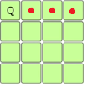
Backtracking Permutation Tree
Q₁
1
1
2
2
2
2
3
10
10
3
10
10
3
10
10
3
10
10
4
6
11
14
11
14
4
6
11
14
11
14
4
6
11
14
11
14
4
6
11
14
11
14
5
7
12
15
12
15
5
7
12
15
12
15
5
7
12
15
12
15
5
7
12
15
12
15

Slide 40
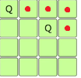
Backtracking Permutation Tree
Q₁
1
4
2
3
Q₂
Q₂
Q₂
Q₂
2
4
1
3
1
4
1
3
3
2
2
2
Q₃
2
4
Q₄

Slide 41
Backtracking Permutation Tree
Q₁
1
4
2
3
Q₂
Q₂
Q₂
Q₂
2
4
1
3
1
4
1
3
3
2
2
2
Q₃
2
4
Q₄

Slide 42
Backtracking Permutation Tree
Q₁
1
4
2
3
Q₂
Q₂
Q₂
Q₂
2
4
1
3
1
4
1
3
3
2
2
2
Q₃
2
4
Q₄

Slide 43
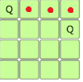
Backtracking Permutation Tree
Q₁
1
4
2
3
Q₂
Q₂
Q₂
Q₂
2
4
1
3
1
4
1
3
3
2
2
2
Q₃
2
4
2
3
Q₄
3

Slide 44
Backtracking Permutation Tree
 | Q
 |  |  | Q
Q
 |  | Q
 |  | Q
Q
 |  |  | Q
 | Q
Q₁
1
4
2
3
Q₂
Q₂
Q₂
Q₂
2
4
1
4
1
4
1
3
3
2
2
Q₃
2
4
2
3
1
4
Q₄
3
2
3

Slide 45
Portion of the Permutation Tree
1
2
1
2
18
4
2
4
1
3
3
3
8
13
19
24
29
2
4
3
2
1
9
11
14
16
30
3
3
15
31
X = {2,4,1,3}

Slide 46
Solutions
Leaf 31
Leaf 39
 | Q
 |  |  | Q
Q
 |  | Q
 |  | Q
Q
 |  |  | Q
 | Q
{ 2 , 4 , 1 , 3 }
{ 3 , 1 , 4 , 2 }

Slide 47
Performance
Brute Force cost = 65
Backtracking:
# nodes generated = 32
# nodes surviving = 18
# parent nodes killed = 14
Gain G = (1-32/65)*100 = 50.8%

Slide 48
(b)The 8-Queens Problem
Place 8 Queens on an 8 x 8 chessboard such that no two can attack each other. How many ways can you choose k things from a set of n items?
In this case there are 64 squares and we want to choose 8 of them to put queens on
64 * 63 * 62 * 61 * 60 * 59 * 58 * 57
= 178,462, 987, 637, 760 / 8!
= 4,426,165,368

Slide 49
8-Queens Problem
Place 8 Queens on an 8 x 8 chessboard such that no two can attack each other. There are about 4.4 billion trials.
Obvious: Each queen must be on a different row. All solutions are 8-tuples
X = (x₁,x₂,..,x₈) , where x_{i} is the column number of the ith queen.
Brute Force Trials: m = 8*8*….*8 = 8⁸ = 2²⁴ = 16 M
Constraint(1) : Each queen must be on a different column. This reduces number of trials to 8! = 40,320
Constraint(2): No two queens can be on the same diagonal.

Slide 50
The 8-Queens Problem (continued)
Backtracking:
will use only 1625 trials
to achieve solution.
Possible Solution:
X = (4 , 6 , 8 , 2 , 7 , 1 , 3 , 5)
 |  |  | Q
 |  |  |  |  | Q
 |  |  |  |  |  |  | Q
 | Q
 |  |  |  |  |  | Q
Q
 |  | Q
 |  |  |  | Q

Slide 51
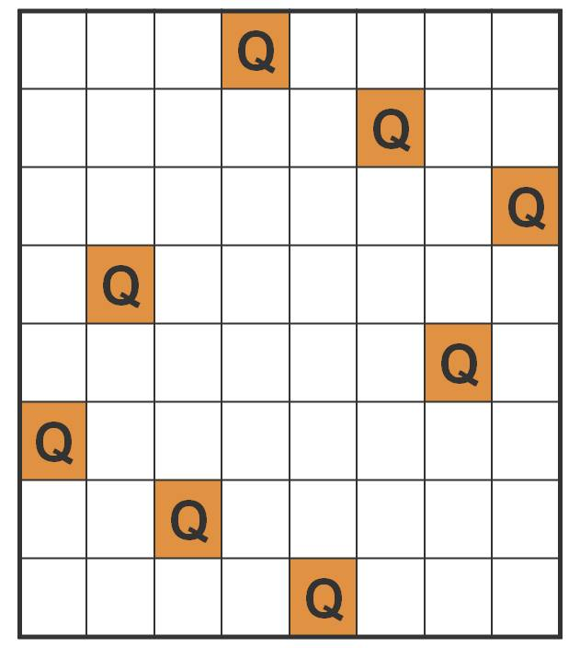
(c)The n-Queens Problem
Find all possible arrangements of n Queens on an n x n chessboard such that no two can attack each other.
Example:
8 queens on an 8x8 board
The problem has 92 solutions.
Only 12 are unique, others are
reflections or rotations.

Slide 52
The n-Queens Problem
Pre-Condition: Each Queen is on a different row.
We seek the n-tuples
X = {x₁ , x₂ , … , x_{n}} representing column numbers satisfying the problem.
Hence, we seek all permutations of X

Slide 53
The Bounding Function
Assume that Queens 1, 2, .. K-1 have already been properly placed.
The bounding function for Queen (k) is that it can be placed in column (i) iff:
It does not share the same column (i) with any of the previous queens (j), j = 1,2,.., k-1, i.e X_{j} ≠ i
It is not on the same diagonal with any of the
previous queens:
│k-j│ ≠ │X_{j} - i│ , j = 1,2,.., k-1
Row j
Q_{j}
Row k
Q_{k}
Col X[ j]
Col (i)

Slide 54
The Bounding Function
bool can_place (x, k, i)
{
for (int j = 1; j < k; j++)
if ((x[ j ] == i) || abs(x[ j ] - i) == abs(k-j))
return false;
return true;
}

Slide 55
Backtracking Algorithm
void Nqueens(x[1..n], k, n)
{
for (i = 1; i <= n; i++)
{
if ( can_place( x, k , i ) )
{
x[k] = i ;
if (k == n) output vector x[1:n];
else NQueens(x, k+1, n);
}
}
}

Slide 56
Another Backtracking Schema
Another schema exists when we replace the bounding function by a function that assigns to x[k] a legal value after x[1: k-1] have already been assigned legal values out of m possible values. If no such value is available, the algorithm backtracks.
Assume the function to be
NextValue (k , n) and the vector x[1:n] is initially set to zero.

Slide 57
The Algorithm
void Backtrack2(x, k, n)
{
do
{
NextValue(x,k,n); //Assign to x[k]
//a legal value
if( !x[k] ) break ; //No possible value
if (k == n) output vector x[1:n];
else Backtrack2(x, k+1, n);
} while(1);
}

Slide 58
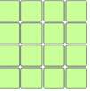
Backtracking
bool isSafe(int i, int j)
for k = 1 to i-1 //check rows
if (x[k] == j OR //same column
|k-i| == |x[k]-j| //same diagonal (dX=dY, slope=1)
return False
return True
(i,j)
(k,l)
Same diagonal since |i-k|=|j-l|
Notes:
//return True if Q can be placed at row i, col j
//x[i] global array w/ first i-1 entries set already: x[a]=b
//means that for row a, Q is safely sitting at col b

Slide 59
Backtracking
void NQueens(int i, int n) //initial call’ll be NQueens(1, N)
for j = 1 to n //check columns
if (isSafe(i, j))
x[i] = j
if (i == n)
printResult(x); //done!
else
NQueens(i+1, n)
i=1
remaining j’s
for this i

Slide 60
Backtracking
void NQueens(int i, int n) //initial call’ll be NQueens(1, N)
for j = 1 to n //check columns
if (isSafe(i, j))
x[i] = j
if (i == n)
printResult(x); //done!
else
NQueens(i+1, n)
i=2
i=1
: remaining j’s
for this i

Slide 61
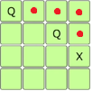
Backtracking
i=1
void NQueens(int i, int n)
for j = 1 to n
if (isSafe(i, j))
x[i] = j
if (i == n)
printResult(x);
else
NQueens(i+1, n)
i=2
i=3
: remaining j’s
for this i
no safe column

Slide 62
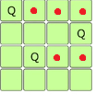
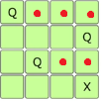
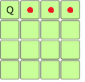
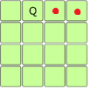
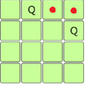
Backtracking
*
i=1 i=2 i=3 i=2 i=3
i=4
i=3
i=2
i=1
i=2
no safe column
no safe column
nothing left
next safe cell
Notes:
remaining j suggested a new safe place, and ..

Slide 63
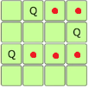
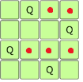
Backtracking
i=1
i=2
void NQueens(int i, int n)
for j = 1 to n
if (isSafe(i, j))
x[i] = j
if (i == n)
printResult(x);
else
NQueens(i+1, n)
i=3
i=4
printResult()
Notes:
remaining j suggested a new safe place, and ..

Slide 64
Backtracking
Let’s see the execution trace along with the Stack
boolean solve(Node n) {
push node n on the stack S;
while S is not empty {
if S.top() node is a leaf {
if it is a goal node, return true
else pop it off S
}
else if S.top() node is unmarked {
Mark S.top() node
for each child c of S.top() node
push c to S
}
else //not a leaf and marked (we are backing out)
pop it off S
return false
}

Slide 65
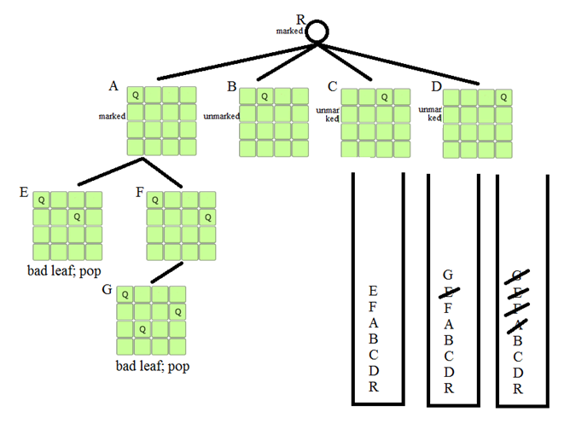
Backtracking

Slide 66
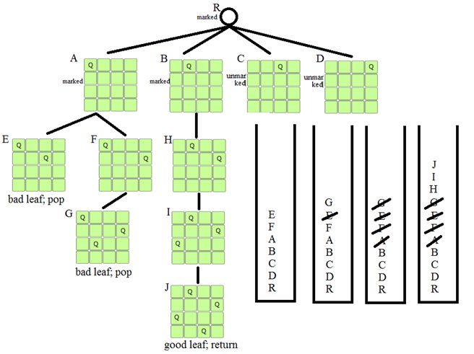
Backtracking

Slide 67
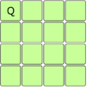
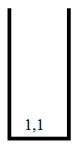
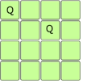
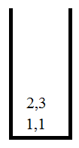
Backtracking
The algorithm using a Stack
F=1 //# of filled rows
F=2

Slide 68
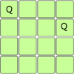
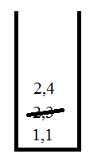
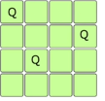
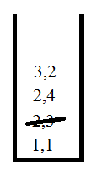
Backtracking
F=2 //pop;
F--; found 2,4;
F++
//(continue from where you left off: 2,3)
F=3

Slide 69
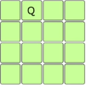
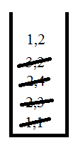
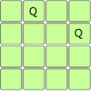
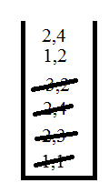
Backtracking
F=1 //pop; F--; try 3,3 and 3,4 in r3; unsafe
//pop; F--; no where to try in row2;
//pop; F--; found 1,2 in row1; F++;
F=2

Slide 70
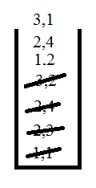
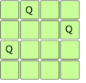
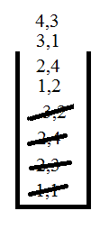
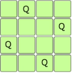
Backtracking
F=4; F reached N (4x4 board); finish

Slide 71
Backtracking
F=4; F reached N (4x4 board); finish

Slide 72


Backtracking
Example puzzle: Balls on the move

Slide 73
Backtracking
Example puzzle: Balls on the move
n black balls, n white balls, 2n+1 spaces, middle empty
Represent the board as an array for the coding: 1,1,-1,2,2 (left)
Blacks/whites can only move to right/left, no backing up
A ball can
move 1 space ahead, if clear
Jump over 1 opposite-color ball, if clear

Slide 74
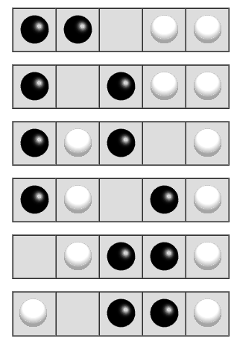
Backtracking
Example puzzle: Balls on the move
A stuck/bad leaf

Slide 75
Backtracking
Example puzzle: Balls on the move
Each move will yield new boards, which become the children of the current board
After some observation on ball movements
bool canMove(int[] board, int idx)
If idx is empty, no move possible (return false)
If idx contains a black ball, check for a valid move to go right
If idx contains a white ball, check for a valid move to go left

Slide 76
Backtracking
Example puzzle: Balls on the move
Each move will yield new boards, which become the children of the current board
After some observation on ball movements
int[] makeMove(int[] oldBoard, int idx)
Make a move from idx on oldBoard and return the new board

Slide 77
Backtracking
Example puzzle: Balls on the move
Resulting recursive code
boolean solvable(int[] board) {
if (puzzleSolved(board)) {
return true;
}
for (int position = 0; position < BOARD_SIZE; position++){
if (canMove(board, position)) {
int[] newBoard = makeMove(board, position);
if (solvable(newBoard)) {
printBoard(newBoard);
return true;
}
}
}
return false;
}

Slide 78
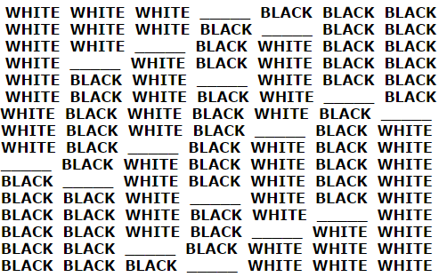
Backtracking
Output of the recursive code (notice the reverse order)

Slide 79
Backtracking
Let’s see the execution trace along with the Stack
boolean solve(Node n) {
push node n on the stack S;
while S is not empty {
if S.top() node is a leaf {
if it is a goal node, return true
else pop it off S
}
else if S.top() node is unmarked {
Mark S.top() node
for each child c of S.top() node
push c to S
}
else //not a leaf and marked (we are backing out)
pop it off S
}
return false }

Slide 80
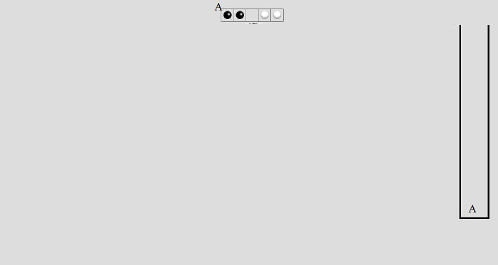

Slide 81
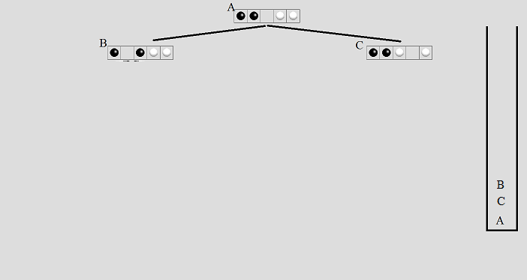

Slide 82
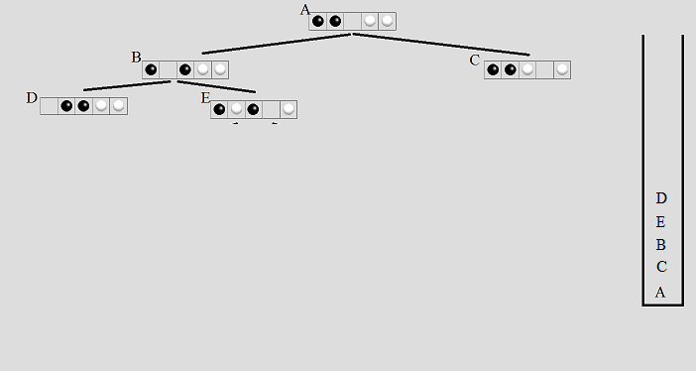
Backtracking

Slide 84
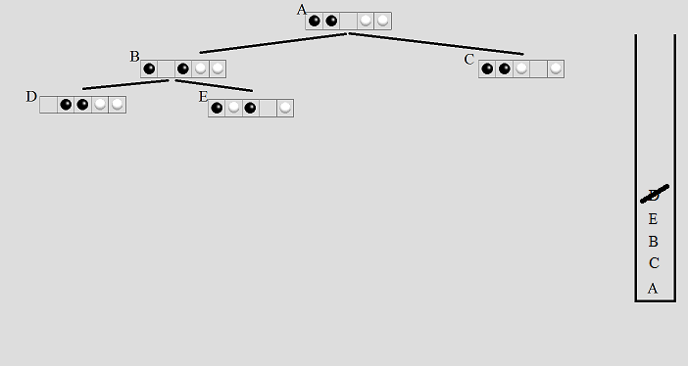

Slide 85
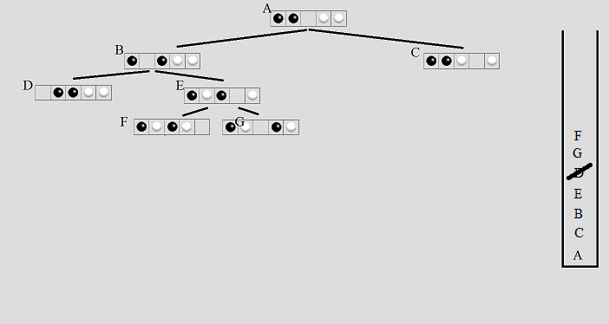

Slide 86
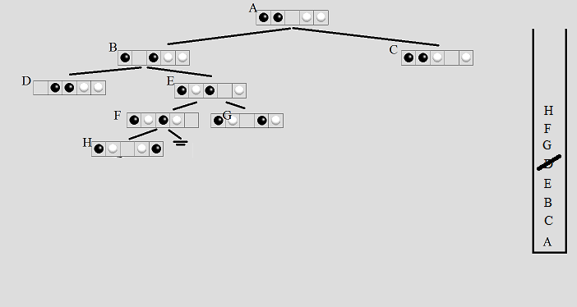

Slide 87
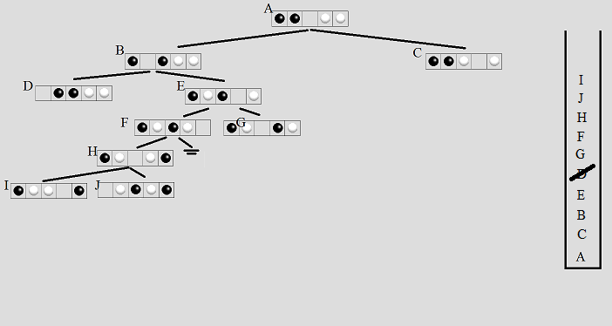

Slide 88
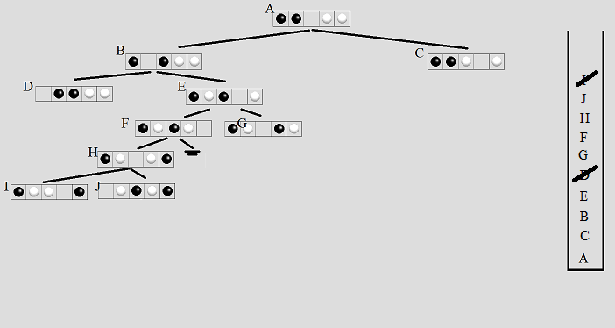

Slide 89
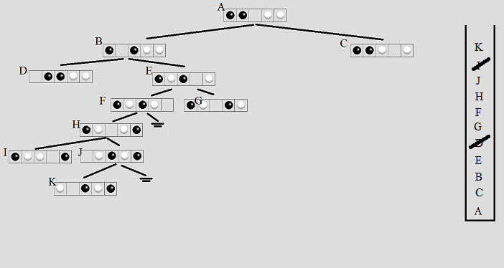

Slide 90
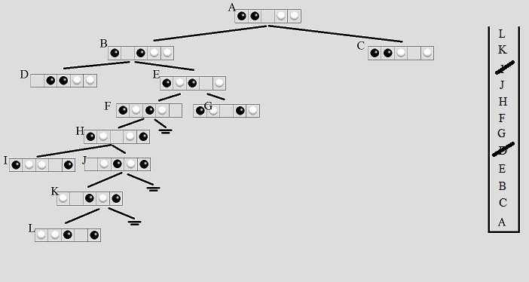

Slide 91
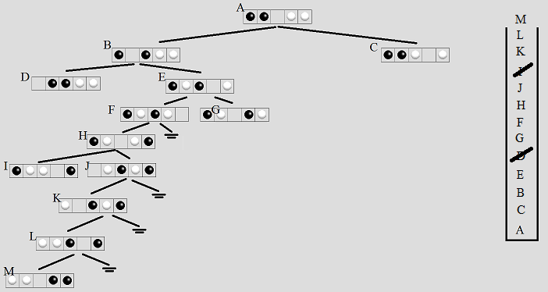

Slide 92


Slide 93
Solution trace: only the marked nodes, e.g., don’t report G or C.

Slide 94
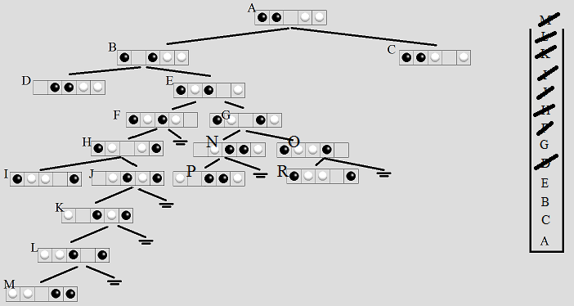
Assume M was a bad leaf
backtrace ‘till G (most recent unmarked node)
G pushes O and N, which later push P and R

Slide 95
Other Backtracking Problems
Knight's Tour
Regular Expressions
Knapsack problem / Exhaustive Search

